Slide 1
Pre-check Punchlist
WebEx -- (Mute on entry/exit and no entry/exit tones) on the setup and delivery of the Field Awareness Sessions. Participant menu.
2nd laptop for screen lag – synch audio and slide
Quiet - Shutoff email / im /google+/etc
Wingman: questions – real time response + end of session
Spin up VMs for Demos / Final check of demo sites.

Slide 2
Apache Atlas: Data Governance
HDP 2.3
July 2015

Slide 3



Shivaji Dutta
Senior Partner
Solutions Engineering
Seetharam Venkatesh
Lead Architect
Atlas Development
Andrew Ahn
Director, Governance
Product Management

Slide 4
Shivaji Dutta
Senior Partner
Solutions Engineering
Andrew Ahn
Director, Governance
Product Management

Slide 5
Agenda
Atlas
Overview
Positioning
Features
Architecture
Ingestion
Demo
Ingestion Use Demo
Custom / Native connectors
Search
Atlas- Ranger
Demo
(HDP 2.3 M10)
Preview
Example
Acess audit
Notes:
We have a lot to cover, want to apologize in advance

Slide 6
Enterprise Data Governance Goals
GOAL: Provide a common approach to data governance across all systems and data within the organization
Transparent Governance standards & protocols must be clearly defined and available to all
Reproducible Recreate the relevant data landscape at a point in time
Auditable All relevant events and assets but be traceable with appropriate historical lineage
Consistent Compliance practices must be consistent
Visualization
& Dashboards
Business Analytics
Governance Framework
ETL/DQ
BPM
MDM
ERP
ARCHIVE
CRM
SCM
Notes:
A data governance framework in any organization comprises a combination of people, process and technology that are in place to establish decision rights and accountabilities for information. A governance policy defines who can take what actions with what information, and when, under what circumstances, using what methods.
The technology goals for a data governance framework are to provide a platform for a common approach across all systems and data within the organization, Explicitly they need to be:
- Transparent: Governance standards & protocols must be clearly defined and available to all
- Reproducible: Recreate the relevant data landscape at a point in time
- Auditable: All relevant events and assets but be traceable with appropriate historical lineage
- Consistent: Compliance practices must be consistent

Slide 7

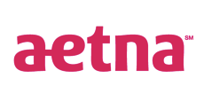





Data Governance Initiative for Hadoop
Visualization
& Dashboards
Data Governance Initiative
TWO Requirements
Hadoop must snap in to the existing frameworks and be a good citizen
Hadoop must also provide governance within its own stack of technologies
Business Analytics
Apache Pig
Apache Hive
Apache HBase
Apache Accumulo
Apache Solr
Apache Spark
Apache Storm
Common Governance Framework
ETL/DQ
BPM
MDM
1
°
°
°
°
°
°
°
°
°
°
°
°
°
°
°
°
°
°
°
°
°
ERP
ARCHIVE
A group of companies dedicated to meeting these requirements in the open
CRM
SCM
Major Bank
Notes:
Consistent with our approach, Hortonworks recently led the development Data Governance Initiative which brings together industry experts from some of the largest enterprise, traditional vendors and Hadoop experts to address governance within Hadoop.
The members have already defined a comprehensive solution for data governance in Hadoop that will provide the base functions of metadata services, deep audit store and an advanced policy rules engine, but also and more importantly, the solution will interoperate with and extend existing third-party data governance and management tools by shedding light on the access of data within Hadoop.
This approach allows organizations to apply comprehensive governance policy across their data.
In order to provide these functions for Hadoop, much work will need to be accomplished throughout all of the Hadoop projects. The initiative is unique in that it is not a spot solution, but will build on top of existing projects such as Apache Falcon for data lifecycle management and Apache Ranger for global security policies.
The founding members of this initiative include, Aetna, Target, Merck, SAS and Hortonworks and many more are lined up to contribute. This is a broad community based initiative set to deliver the right features for the right requirements and is perfectly representative of the Hortonworks open community approach.

Slide 8


Core Capabilities of HDP 2.3
DATA ACCESS
GOVERNANCE & INTEGRATION
SECURITY
OPERATIONS
Hortonworks Data Platform 2.3
DATA MANAGEMENT
Data Lifecycle & Governance
Falcon
Atlas
Batch
MapReduce
Script
Pig
SQL
Hive
NoSQL
HBase
Accumulo
Phoenix
Stream
Storm
Search
Solr
In-memory
Spark
Others
ISV Engines
Administration
Authentication
Authorization
Audit
Data Protection
Ranger
Knox
Atlas
HDFS DARE
Provision, Manage, & Monitor
Ambari
Cloudbreak
Zookeeper
Tez
Tez
Tez
Slider
Slider
YARN : Data Operating System
Data Workflow
Sqoop
Flume
Kafka
NFS
WebHDFS
HDFS Hadoop Distributed File System
1
°
°
°
°
°
°
°
°
°
°
Scheduling
Oozie
°
°
°
°
°
°
°
°
°
°
N
Deployment Choice
Linux
Windows
On-Premise
Cloud

Slide 9
Core Capabilities of HDP 2.3
DATA ACCESS
GOVERNANCE & INTEGRATION
SECURITY
OPERATIONS
Hortonworks Data Platform 2.3
DATA MANAGEMENT
Data Lifecycle & Governance
Falcon
Atlas
Batch
MapReduce
Script
Pig
SQL
Hive
NoSQL
HBase
Accumulo
Phoenix
Stream
Storm
Search
Solr
In-memory
Spark
Others
ISV Engines
Administration
Authentication
Authorization
Audit
Data Protection
Ranger
Knox
Atlas
HDFS DARE
Provision, Manage, & Monitor
Ambari
Cloudbreak
Zookeeper
Tez
Tez
Tez
Slider
Slider
YARN : Data Operating System
Data Workflow
Sqoop
Flume
Kafka
NFS
WebHDFS
HDFS Hadoop Distributed File System
1
°
°
°
°
°
°
°
°
°
°
Scheduling
Oozie
°
°
°
°
°
°
°
°
°
°
N
Deployment Choice
Linux
Windows
On-Premise
Cloud

Slide 10
Apache Atlas Overview
We Do Hadoop

Slide 11
What is Apache Atlas ?
Hive
Ranger
Falcon
Kafka
Storm
Apache Atlas
Notes:
One of the most important and challenging goals is consistency and when we inspect implementation of data governance for a Hadoop implementation this consistency seems almost impossible.
While there are constructs within the various Hadoop related projects to aid governance, there is no single, consistent approach to implementation/architecture of this important framework. Disparate tools, such as HCatalog, Ranger and Falcon provide pieces of the overall solution, but are not holistic across the stack in approach.
Further, with Hadoop gaining traction in the enterprise, it has only recently been asked to integrate with existing frameworks such as operations, security and now governance. It is now a foundational concern.

Slide 12
What is Apache Atlas ?
Metadata
Hive
Ranger
Falcon
Kafka
Storm
Apache Atlas
Notes:
One of the most important and challenging goals is consistency and when we inspect implementation of data governance for a Hadoop implementation this consistency seems almost impossible.
While there are constructs within the various Hadoop related projects to aid governance, there is no single, consistent approach to implementation/architecture of this important framework. Disparate tools, such as HCatalog, Ranger and Falcon provide pieces of the overall solution, but are not holistic across the stack in approach.
Further, with Hadoop gaining traction in the enterprise, it has only recently been asked to integrate with existing frameworks such as operations, security and now governance. It is now a foundational concern.

Slide 13
Apache Atlas Vision 2015
Metadata Services
Business Taxonomy - classification
Operational Data – Model for Hive: DB, Tables, Col,
Centralized location for all metadata inside HDP
Single Interface point for Metadata Exchange with platforms outside of HDP.
Search & Proscriptive Lineage – Model and Audit
Hive
Ranger
Falcon
Kafka
Storm
Apache Atlas
Notes:
One of the most important and challenging goals is consistency and when we inspect implementation of data governance for a Hadoop implementation this consistency seems almost impossible.
While there are constructs within the various Hadoop related projects to aid governance, there is no single, consistent approach to implementation/architecture of this important framework. Disparate tools, such as HCatalog, Ranger and Falcon provide pieces of the overall solution, but are not holistic across the stack in approach.
Further, with Hadoop gaining traction in the enterprise, it has only recently been asked to integrate with existing frameworks such as operations, security and now governance. It is now a foundational concern.

Slide 14
What is available now versus later ?
Metadata Services – HDP 2.3
Business Taxonomy - classification
Operational Data – Model for Hive: DB, Tables, Col,
Centralized location for all metadata inside HDP
Single Interface point for Metadata Exchange with platforms outside of HDP.
Metadata will enrich every component
Hive – Complete lineage, every SQL tracked – HDP 2.3
Ranger – Tag or Attribute security ABAC – M20
Falcon – Business Taxonomy – M20
Now
DAL
DAL M20
ERIE
Hive
Ranger
Falcon
Kafka
Storm
Apache Atlas
Now
Notes:
One of the most important and challenging goals is consistency and when we inspect implementation of data governance for a Hadoop implementation this consistency seems almost impossible.
While there are constructs within the various Hadoop related projects to aid governance, there is no single, consistent approach to implementation/architecture of this important framework. Disparate tools, such as HCatalog, Ranger and Falcon provide pieces of the overall solution, but are not holistic across the stack in approach.
Further, with Hadoop gaining traction in the enterprise, it has only recently been asked to integrate with existing frameworks such as operations, security and now governance. It is now a foundational concern.

Slide 15
Overlap with Falcon ?
Atlas provides: Metadata
Business Classification (taxonomy): Retail Division> Department > Shoes
Hierarchy with Inheritance of attribute to child objects: Sensitive “PII” tag of department HR will be inherited by group HR>Benefits
Repository for any HDP or external reporting via REST API’s
Does not orchestrate any action in HDP
Comprehensive….but not instance-based.
Falcon provides: Life Cycle
Excels with data handling – movement, archival, eviction
Definition, monitoring and tracing of Falcon pipeline entities and instances only.
Can be used to label feeds, processes, & clusters but not based on any defined taxonomy (free-form tagging)
Atlas provides taxonomy to replace labels in Falcon
Hive
Ranger
Falcon
Kafka
Storm
Apache Atlas
Notes:
Apache Atlas = low level service like yarn. It will be common to the whole HDP platform, providing core metadata services and enriching the whole HDP stack. We start with Hive in HDP 2.3 and will extend to Ranger and Falcon in M10 and continue with Kafka and Storm by the end of 2015.
Yellow + Atlas = goverance features.

Slide 16
Apache Atlas Capabilities: Overview
Taxonomy - Data Classification – HDP 2.3
Import or define taxonomy business-oriented annotations for data
Define, annotate, and automate capture of relationships between data sets and underlying elements including source, target, and derivation processes
Export metadata to third-party systems
Centralized Auditing - Erie
Capture security access information for every application, process, and interaction with data
Capture the operational information for execution, steps, and activities
Search & Lineage (Browse) – HDP 2.3
Pre-defined navigation paths to explore the data classification and audit information
Text-based search features locates relevant data and audit event across Data Lake quickly and accurately
Browse visualization of data set lineage allowing users to drill-down into operational, security, and provenance related information
Security & Policy Engine - Dal M20
Rationalize compliance policy at runtime based on data classification schemes
Advanced definition of policies for preventing data derivation based on classification (i.e. re-identification)
Now
Healthcare
HIPAA
HL7
Financial
SOX
Dodd-Frank
Energy
PPDM
Retail
PCI
PII
Other
CWM
REST API
Services
Apache Atlas
Search
Lineage
Exchange
Knowledge Store
Data Lifecycle Management
Now
Taxonomies
Policy Rules
Type-System
Models
Tag Based Policies
Audit Store
Real Time Tag Based Access Control
Notes:
Roll tax into data disco

Slide 17
Apache Atlas Overview
Taxonomy availabe – HDP 2.3
Knowledge store categorized with appropriate business-oriented taxonomy
Data sets & objects
Tables / Columns
Logical context
Source, destination
Support exchange of metadata between foundation components and third-party applications/governance tools
Leverages existing Hadoop metastores
Now
Healthcare
HIPAA
HL7
Financial
SOX
Dodd-Frank
Custom
CWM
Retail
PCI
PII
Other
REST API
Services
Apache Atlas
Search
Lineage
Exchange
Knowledge Store
Policy Engine
Taxonomies
Policy Rules
Type-System
Models
Data Lifecycle Management
Audit Store
Security
Notes:
CWM – common warehouse metamodel.
Default way to build out the model scaffolding – Meta integration uses this to OE to informatica.

Slide 18
Business Taxonomy Example
Company
Products
Vehicles
Human Resources
Sales
Dealers
Drivers
Timesheets
Customers
Motorcycles
Automobiles
Trucks
Sedans
Midsize
Compact
F150
F250

Slide 19
Business Taxonomy Inheritance
Parent
Human Resources
Drivers
Timesheets
PII

Slide 20
Business Taxonomy Inheritance
Parent
Human Resources
Drivers
(Dimension)
Timesheets
(Facts)
PII
PII
Child
Child
PII

Slide 21
Apache Atlas Overview
Data Lifecycle Management - Erie
Leverage existing investment in Apache Falcon with a focus on:
Provenance
Multi-cluster replication
Data set retention/eviction
Late data handling
Automation
Taxonomy from Atlas to replace free form labels.
Healthcare
HIPAA
HL7
Financial
SOX
Dodd-Frank
Custom
CWM
Retail
PCI
PII
Other
REST API
Services
Apache Atlas
Search
Lineage
Exchange
Knowledge Store
Policy Engine
Taxonomies
Policy Rules
Type-System
Models
Data Lifecycle Management
Audit Store
Security
Notes:
CWM – common warehouse metamodel.
Default way to build out the model scaffolding – Meta integration uses this to OE to informatica.

Slide 22
Apache Atlas Overview
Audit Store - Erie
Integrate with Log Search effort. Historical repository for all governance events
Security: Access Grant & Deny
Operational: Data Provenance & Metrics
Indexed and Searchable
Healthcare
HIPAA
HL7
Financial
SOX
Dodd-Frank
Custom
CWM
Retail
PCI
PII
Other
REST API
Services
Apache Atlas
Search
Lineage
Exchange
Knowledge Store
Policy Engine
Taxonomies
Policy Rules
Type-System
Models
Data Lifecycle Management
Audit Store
Security
Notes:
CWM – common warehouse metamodel.
Default way to build out the model scaffolding – Meta integration uses this to OE to informatica.

Slide 23
Apache Atlas Overview
Tag-Based Policy – Dal M20
Run time rationalization of policies rules with respect to data asset combinations and time. Fully extensible.
Tag base rules
Geo based rules
Time-based rules
Hive Column Prohibitions
Healthcare
HIPAA
HL7
Financial
SOX
Dodd-Frank
Custom
CWM
Retail
PCI
PII
Other
REST API
Services
Apache Atlas
Search
Lineage
Exchange
Knowledge Store
Policy Engine
Taxonomies
Policy Rules
Type-System
Models
Data Lifecycle Management
Audit Store
Security
Notes:
CWM – common warehouse metamodel.
Default way to build out the model scaffolding – Meta integration uses this to OE to informatica.

Slide 24
Apache Atlas Overview
RESTful interface - HDP 2.3
Extensible enterprise classification of data assets, relationships and policies organized in a meaningful way -- aligned to business organization.
Supports exploration via user interface
Supports extensibility via API and CLI exposure
Now
Healthcare
HIPAA
HL7
Financial
SOX
Dodd-Frank
Custom
CWM
Retail
PCI
PII
Other
REST API
Services
Apache Atlas
Search
Lineage
Exchange
Knowledge Store
Policy Engine
Taxonomies
Policy Rules
Type-System
Models
Data Lifecycle Management
Audit Store
Security
Notes:
CWM – common warehouse metamodel.
Default way to build out the model scaffolding – Meta integration uses this to OE to informatica.
** Can run on any posix system. In hadoop or outside. On premise or in the cloud. Flexible.

Slide 25

Gov Ready Certification Program - M20
Discovery
Tagging
Prep / Cleanse
ETL
Governance
BPM
Self Service
Visual-ization
Curated group of vendor partners to provide rich & complete features
Customers choose features that they want to deploy – a la carte.
Low switching costs !
HDP at core to provide stability and interoperability
Notes:
Which Vendors would you be interested in ?

Slide 26
Key Concepts
Business Taxonomy (Classification) – The practice and science of classification of things or concepts, including the principles that underlie such classification. The business logical organization model includes hierarchical & inheritance.
Data Lineage (Provenance) – Data lineage is defined as a data life cycle that includes the data's origins and where it moves over time.” It describes what happens to data as it goes through diverse processes. It helps provide visibility into the analytics pipeline and simplifies tracing errors back to their sources.
Tags: Traits vs Label – Falcon has free form labels. Atlas has Traits (aka Tags) that are hierarchical and prevent duplication

Slide 27
Architecture

Slide 28
High Level Architecture
REST API
Bridge
Search DSL
Hive
Storm
Sqoop
Others
Type System
Solr/Elastic
Repository
Titan / HBase

Slide 29
Technology Stack
Knowledge Store
Titan Graph DB
Pluggable Search Backend
Solr – M10
Elastic search
Rules Engine - Fenton
TBD
Audit Store - Erie
YARN ATS - Time series DB
Java 1.7 +
Front-End
Angularjs / Bootstrap
D3

Slide 30
Tech Preview APIs: Jan 2015
Admin
GET: /admin/stack
GET: /admin/version
Entity
GET: /entities/definition/{guid}
POST: /entities/submit/{typeName}
GET: /entities/list/{entityType}
Metadata Discovery
GET: /discovery/search/gremlin/{gremlinQuery}
GET: /discovery/search/relationships/{guid}
GET: /discovery/search/fullText?text=<query>
GET: /discovery/getIndexedFields
Rexster
GET: /graph/vertices/{id}
GET: /graph/vertices/properties/{id}
GET: /graph/vertices
GET: /graph/vertices/{id}/{direction}
GET: /graph/edges/{id}
Types
POST: /types/submit/{typeName}
GET: /types/definition/{typeName}
GET: /types/list
Hive Lineage
GET: /bridge/hive/{id}
GET: /bridge/hive
POST: /bridge/hive

Slide 31
Type System – Overview of Types
Class
Struct
Trait
Primitives
Collections
Map
Array
Instances (Entity)
Referenceable

Slide 32
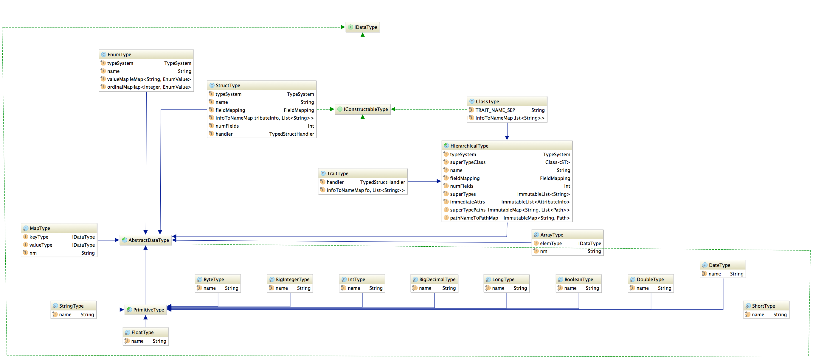
Type System – Data Types

Slide 33
_trait("Dimension") {}
_trait("PII") {}
_trait("Metric") {}
_trait("ETL") {}
_trait("JdbcAccess") {}
_class("DB") {
"name" ~ (string, required, indexed, unique)
"owner" ~ (string)
"createTime" ~ (int)
}
_class("StorageDesc") {
"inputFormat" ~ (string, required)
"outputFormat" ~ (string, required)
}
_class("Column") {
"name" ~ (string, required)
"dataType" ~ (string, required)
"sd" ~ ("StorageDesc", required)
}
_class("Table", List()) {
"name" ~ (string, required, indexed)
"db" ~ ("DB", required)
"sd" ~ ("StorageDesc", required)
}

Slide 34
Repository
Graph Database
Titan with storage backed by HBase
Types and instances are mapped to the Graph DB
Classes, Structs and Traits map to a vertex
Relationships are mapped as edges
Search - plugin enabled
Indexing based on type annotations
Solr
Elastic search

Slide 35
Search
DSL with SQL Like Syntax
from $type is $trait where $clause select|has $attributes loop $loopExpression withPath, repeat
Examples
from DB
DB where name="Reporting" select name, owner
DB has name
DB is JdbcAccess
Column where Column isa PII
Table where name="sales_fact", columns
Table where name="sales_fact", columns as column select column.name, column.dataType, column.comment
Full-text search

Slide 36
Lineage
Uses Search DSL Loop expression
Everything results in search
Named Queries
inputs
Table where (name = \"sales_fact_monthly_mv\") as src loop (LoadProcess->outputTable inputTables) as dest select src.name as src_name, dest.name as dest_name withPath
outputs
Table where (name = \"sales_fact\") as src loop (LoadProcess->inputTables outputTables) as dest select src.name as src_name, dest.name as dest_name withPath
schema
Table where name="sales_fact", columns

Slide 37
Hive Integration
Hive Bridge
(Client)
Hive Hook
(Post-execution)
REST API
Apache Atlas

Slide 38
Key Concepts
Component Model – Parts of a HDP component. For example, Hive has DB’s, Tables and Columns.
Compliance Standards: HIPAA, PPDM, PCI, etc.
Types – what is it ? Traits – what is it ? Create additional slide concepts
Flexible Type Systems
Custom Connector – Customer reporter to Atlas using REST API
Native Connecter – Hive connector, automatically captures all SQL run against HiveServer2

Slide 39
Apache Atlas Screens

Slide 40
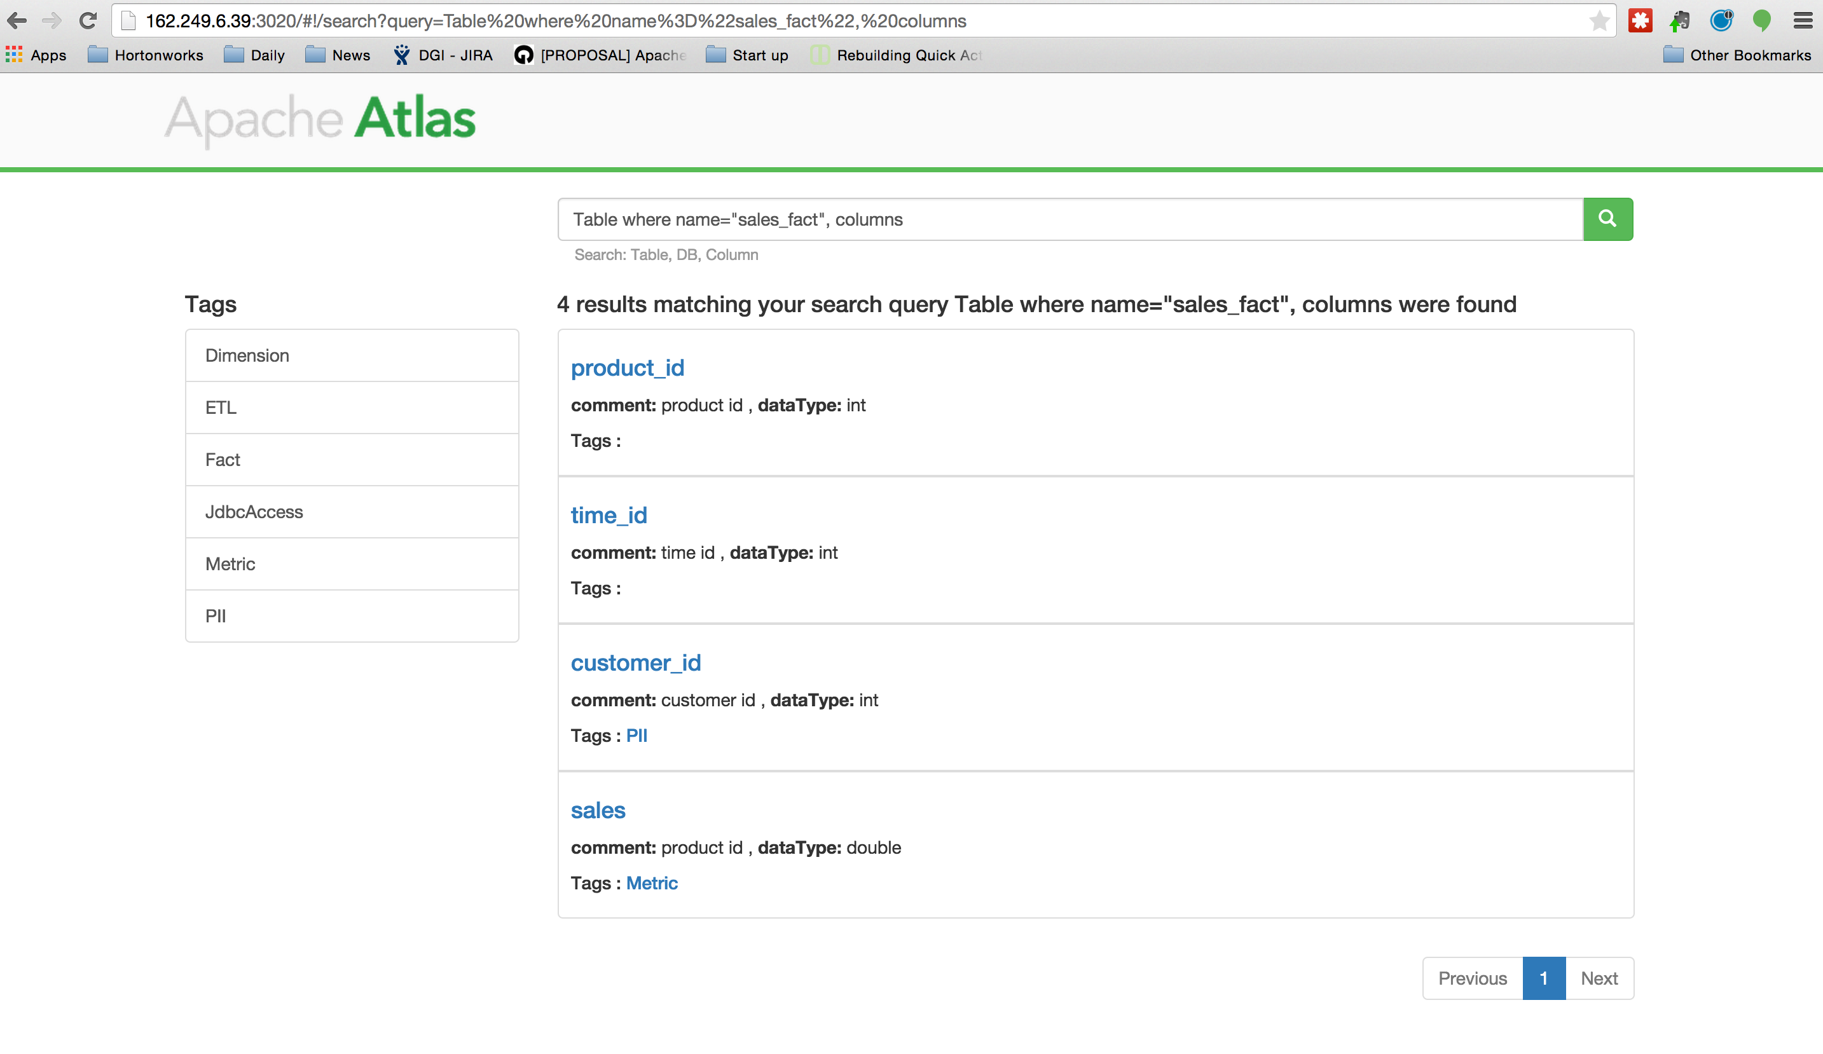

Slide 41
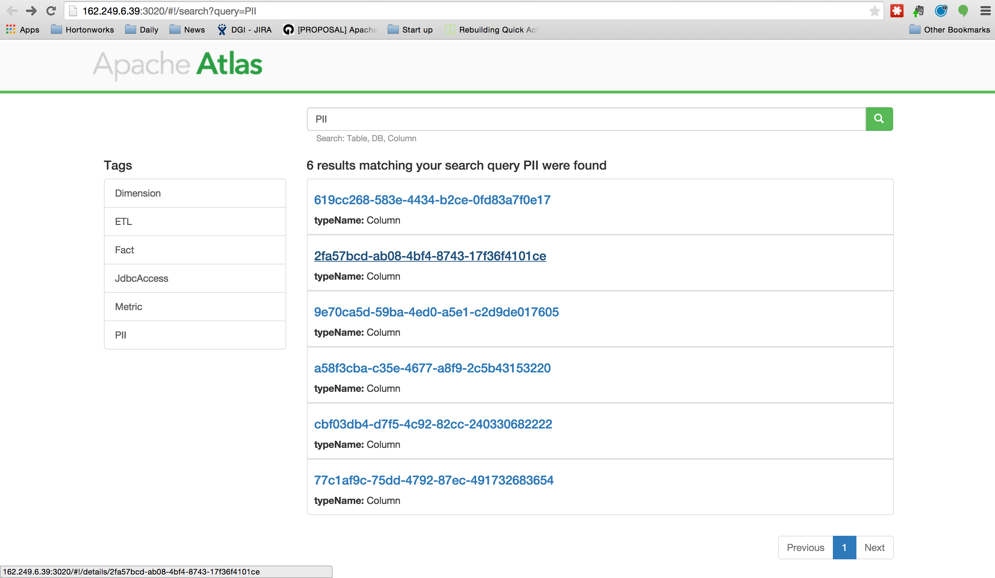

Slide 42
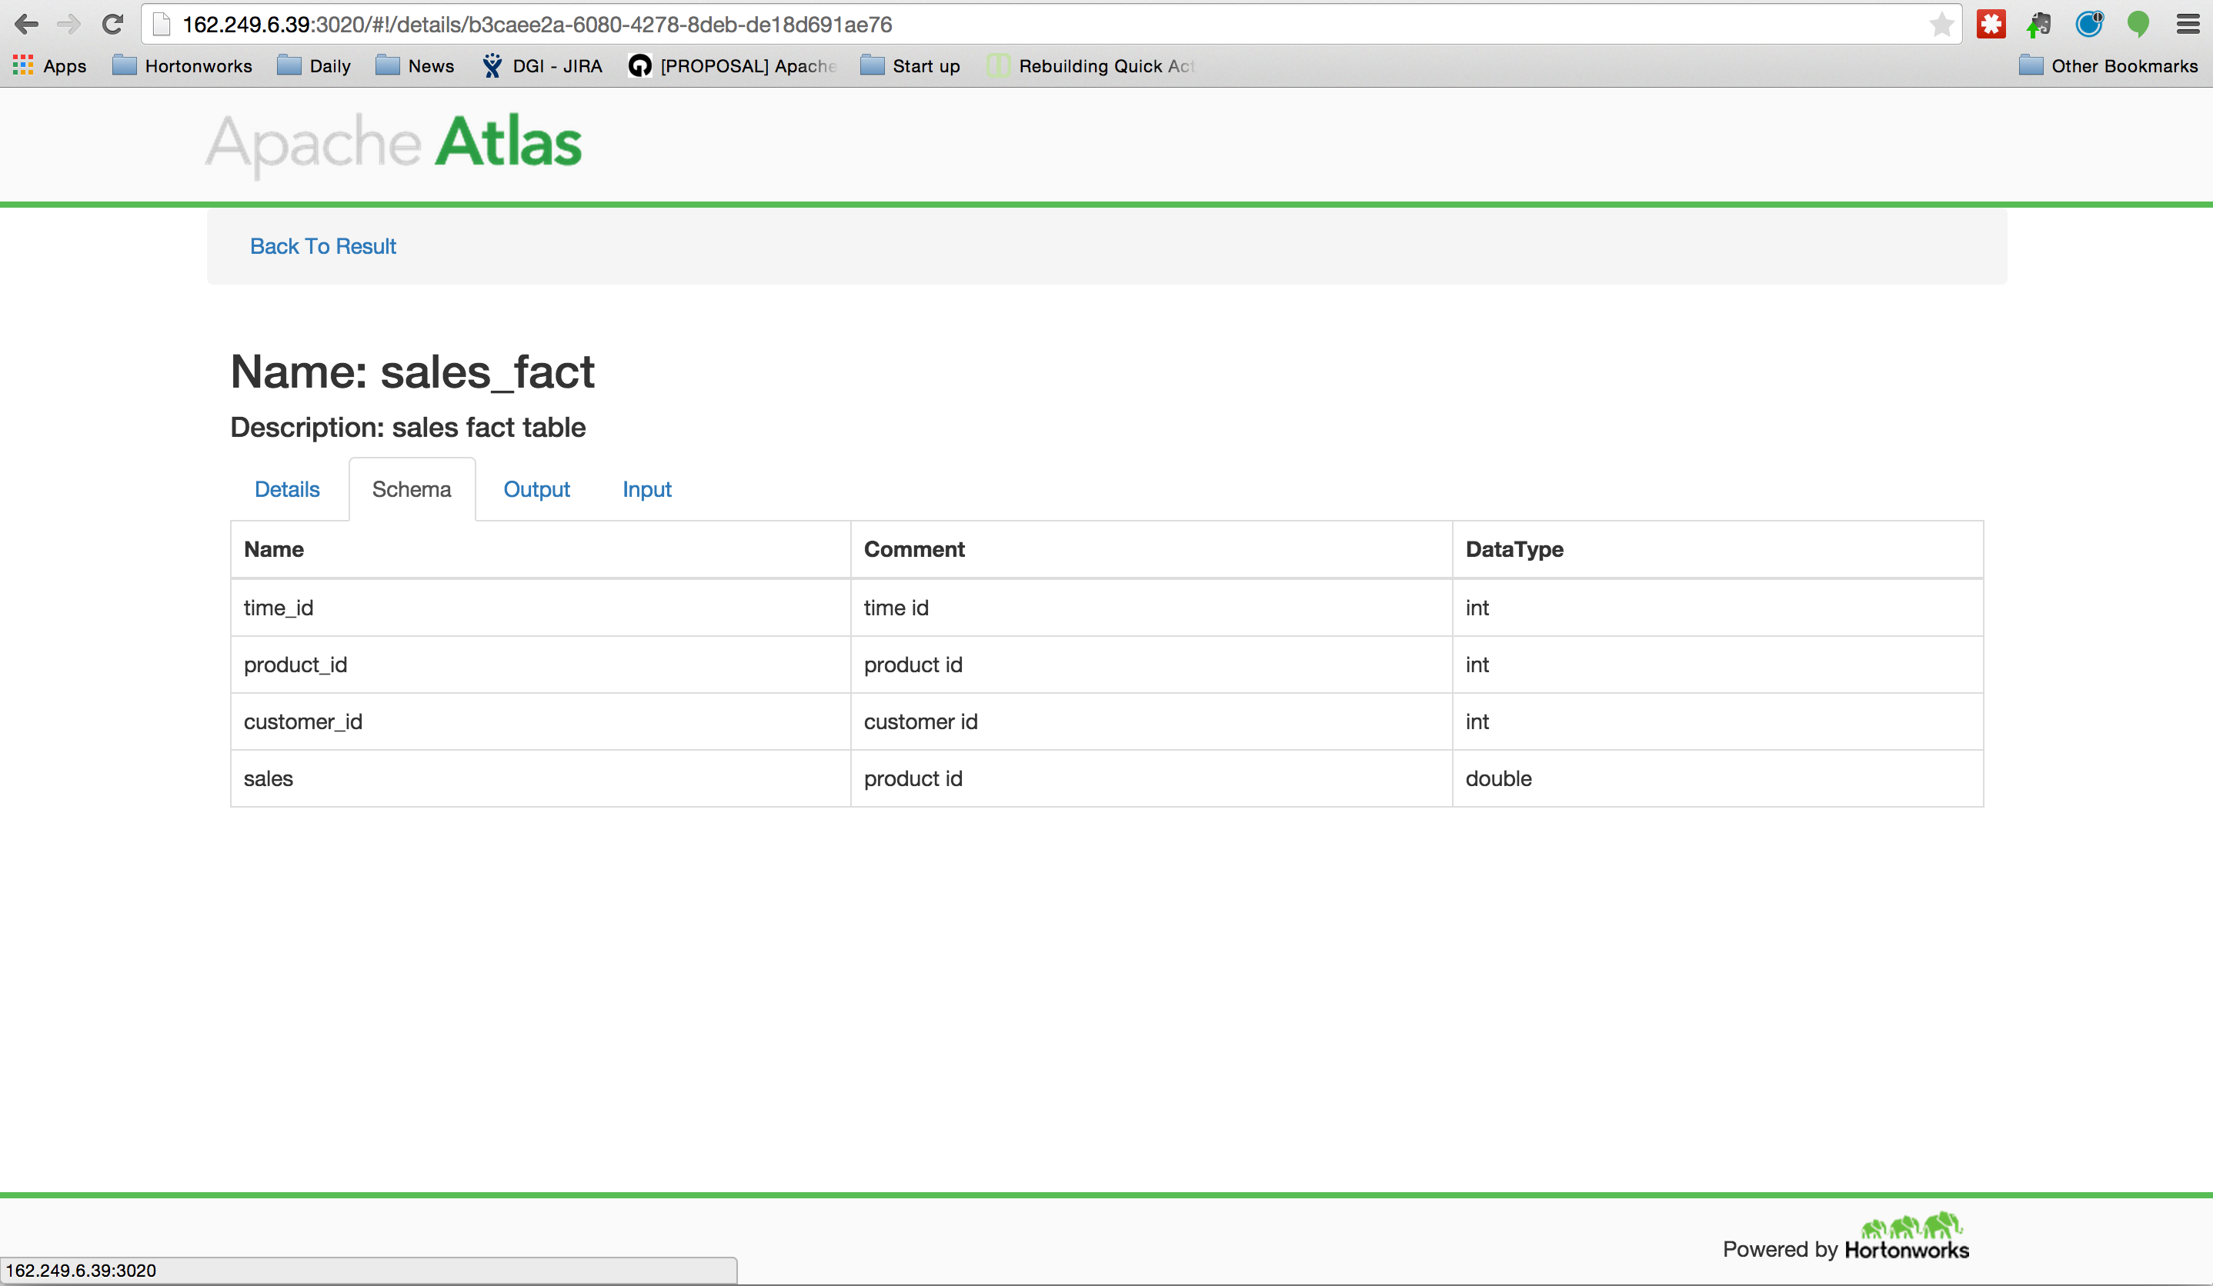

Slide 43
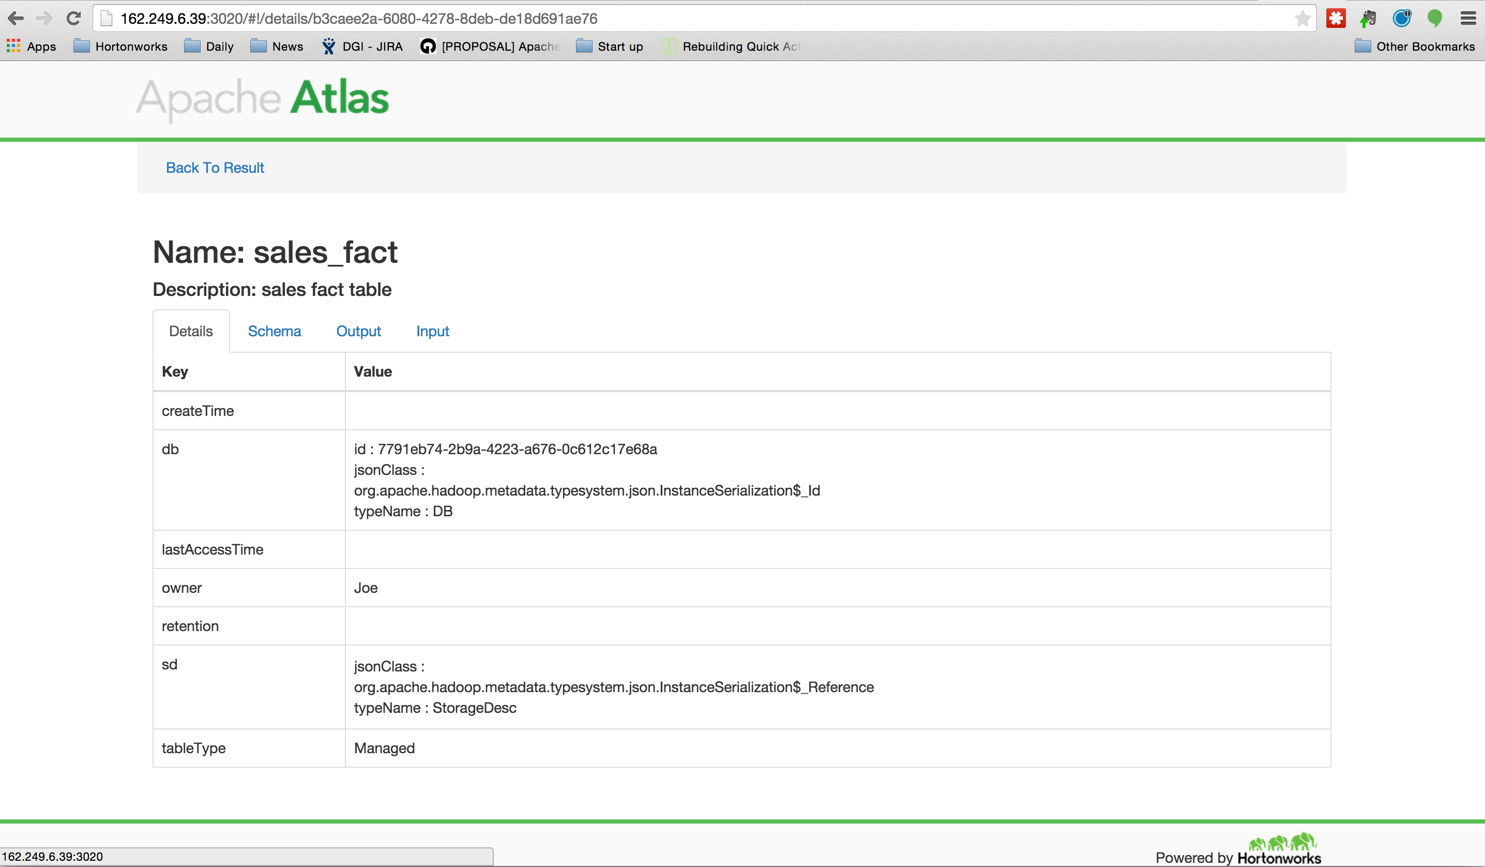

Slide 44
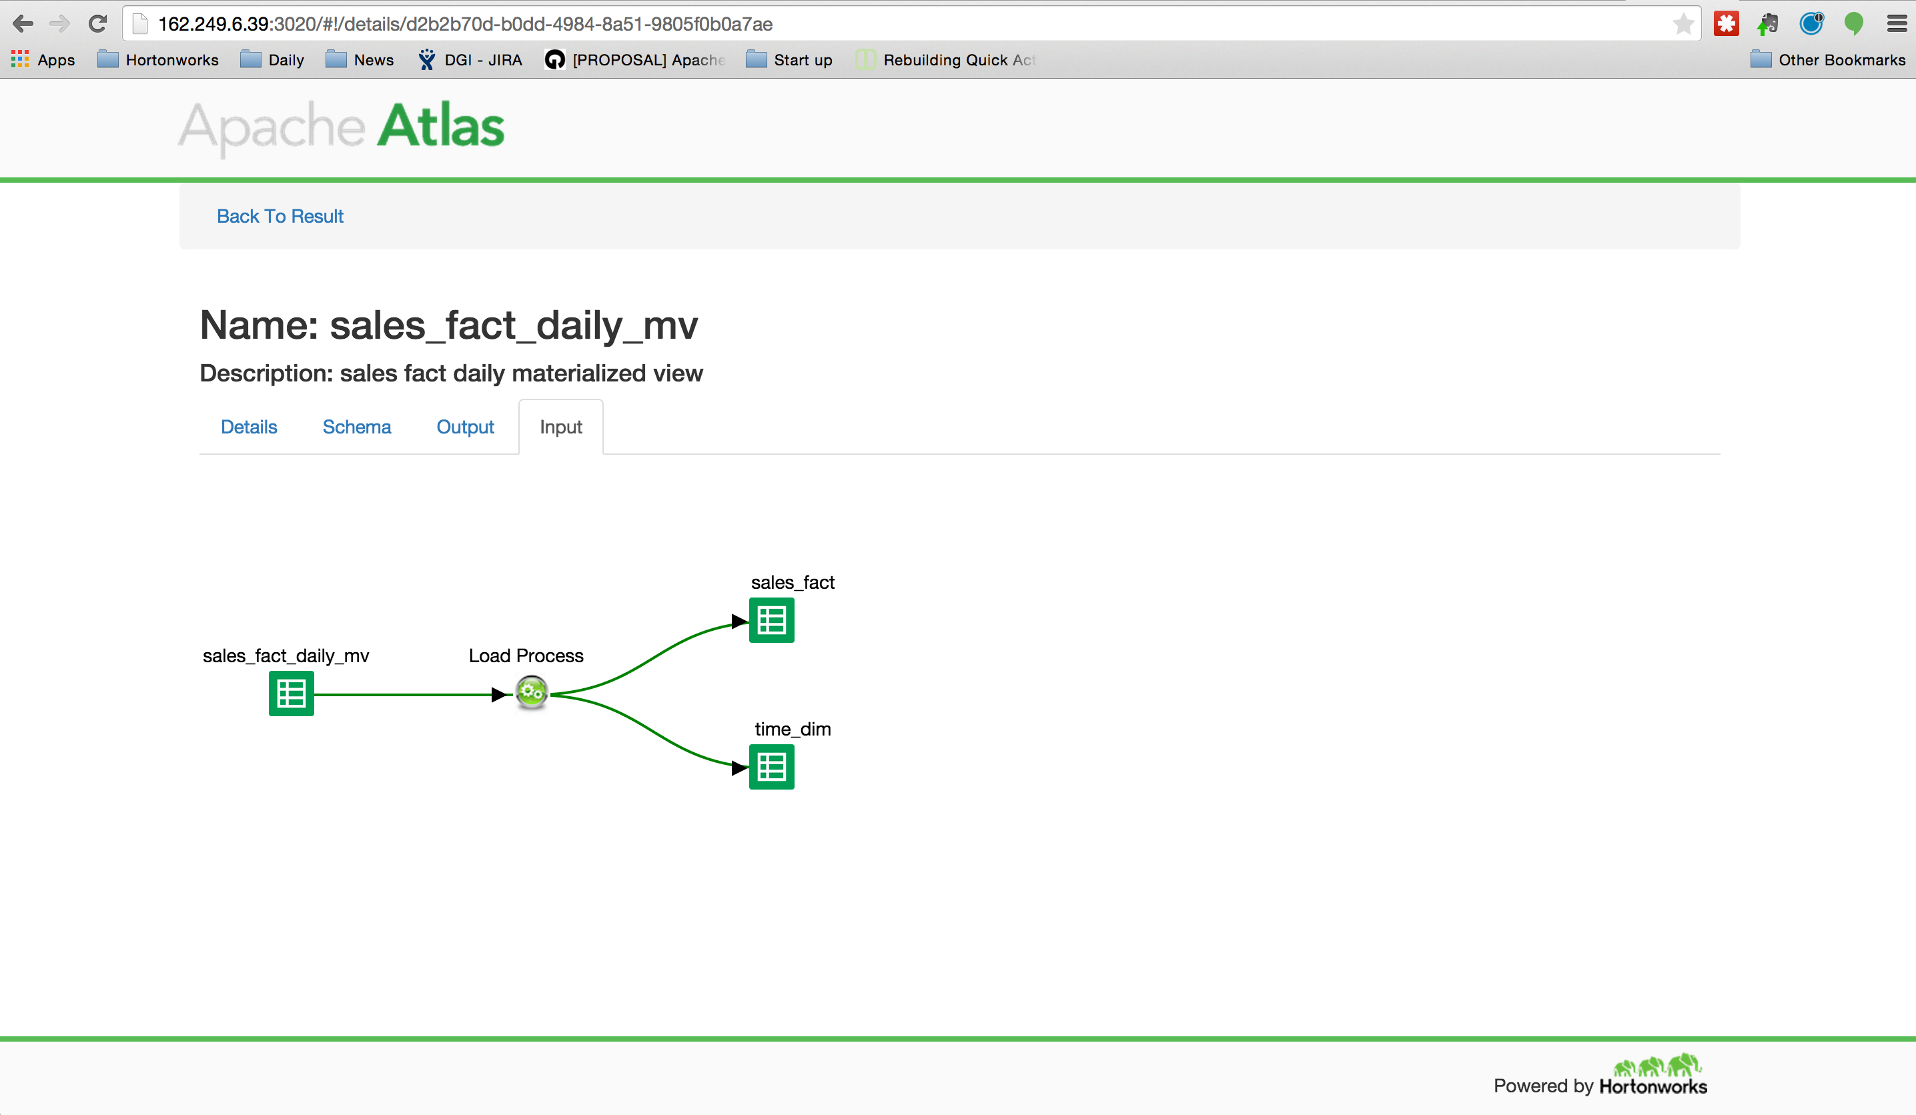

Slide 45
Demo: Ingestion & ETL

Slide 46
What can you do with Atlas now ? Ingestion & ETL Demo
The objective is to show a data ingestion workflow that starts from a traditional RDBMS which lands data in Hadoop for further analysis (ETL)
Leveraging Apache Atlas, proper workflow lineage with:
Apache Sqoop pulling from Mysql
Landing in Apache Hive
ETL+ CTAS to create a new table in Hive
Lineage outside Hadoop and within:
Custom connector:
Show Lineage with Sqoop Ingestion of data
Native connector:
Hive Hook CTAS Operation
Search by data asset, or tag - DSL

Slide 47
Sample Use Case: Ingestion & ETL
Load Wrapper
RDMS
Table 1
Table 2
Hive:
Landing
Table 1
Table 2
Hive:
Table 3
Sqoop
ETL
Business Catalog
Metadata
Reporter
REST API
Atlas
Metadata
Traditional
EDW
New ETL
Hadoop
Notes:
Show – clearly identify customer metadata. Change
Add customer classification example – Aetna – make the use case story have continuity. Use DX procedures to diagonsis
** bring meta from external systems into hadoop – keep it together

Slide 48
Demo: Governance Ingestion & ETL
Search
DSL - Domain Specific Language – SQL like.
Data Asset
By Tag
Sample Code

Slide 49
Demo: Setup
Source System
VM 1 – Source System
MySQL Database
DRIVERS Table
TIMESHEET Table
VM 2 – Destination System
Single Node HDP 2.3 (Tech Preview)
Apache Atlas

Slide 50
Demo: Steps to Create Metadata
Create a Atlas Client Instance
Create Type Definitions
Class Types
Attributes
List the Types
Instantiate Entities
- Create Entities (Class Type)
- Search the Types
Create Process
Create DataSet Type
Create Process Type
Connect a Process Lineage

Slide 51
Demo: Attribute Definition
Name
Data Type
Multiplicity
Composite
isIndexable
ReverseAttribute

Slide 52
Tag Based Ranger Policy Example
Progress demo from current sprints: June 2015

Slide 53
How does Falcon work with Ranger?
Atlas provides: Metadata
Business Classification (taxonomy): Company > HR > Driver
Hierarchy with Inheritance of attribute to child objects: Sensitive “PII” tag of department HR will be inherited by group HR> Driver
Atlas will notify Ranger via Kafka Topic for changes
Atlas provides the metadata tag to create policies
Hive
Ranger
Falcon
Kafka
Storm
Ranger provides: Access & Entitlements
Ranger will cache tags and asset mapping for performance
Ranger will have a policy based on tags instead of roles.
Example: PII = <group> This can work for a may assets.
Apache Atlas
Notes:
Apache Atlas = low level service like yarn. It will be common to the whole HDP platform, providing core metadata services and enriching the whole HDP stack. We start with Hive in HDP 2.3 and will extend to Ranger and Falcon in M10 and continue with Kafka and Storm by the end of 2015.
Yellow + Atlas = goverance features.

Slide 54
Hive schema and tags - Atlas
Database | default | finance | hr
Table | table1 | invoice | employee
Columns | column1, column2 | id, vendor, ssn, amount | id, name, ssn
Tags | None | FINANCE – db=finance | PII – column=employee.ssn
Notes:
Give a brief overview of the presentation. Describe the major focus of the presentation and why it is important.
Introduce each of the major topics.
To provide a road map for the audience, you can repeat this Overview slide throughout the presentation, highlighting the particular topic you will discuss next.

Slide 55
Tag-based policies - Ranger
TAG-Names | Users | Permissions
FINANCE | fin_user | select
 | fin_admin | all
 | other users | no access
PII | hr_admin | all
 | other users | no access
Notes:
This is another option for an overview using transitions to advance through several slides.

Slide 56
Queries & outcomes
Query |  | fin_user | fin_admin | hr_user | hr_admin
select * from default.table1; | Resource | Y | Y | Y | Y
 | Tag & Resource | Y | Y | Y | Y
select * from finance.invoice; | Resource | Y | Y | N | N
 | Tag & Resource | Y | Y | N | N
insert into finance.invoice (id, vendor, amount) VALUES (2, ‘vendor 2’, 1500000); | Resource | Y | Y | N | N
 | Tag & Resource | N | Y | N | N
select * from hr.employee; | Resource | N | N | Y | Y
 | Tag & Resource | N | N | N | Y
select id, name from hr.employee; | Resource | N | N | Y | Y
 | Tag & Resource | N | N | Y | Y
Notes:
Demo for Tag-based Ranger Policies

Slide 57
Tag based Access Policy Review
Basic Tag policy – PII example
Geo- based policy -- Policy based on IP address, proxy IP substitution maybe required
Time based policy -- Timer for data access, de-coupled from deletion of data.
Prohibitions -- Prevention of combination of Hive tables that may pose a risk together

Slide 58
Apache Atlas Roadmap

Slide 59
Disclaimer
This document may contain product features and technology directions that are under development, may be under development in the future or may ultimately not be developed.
Project capabilities are based on information that is publicly available within the Apache Software Foundation project websites ("Apache"). Progress of the project capabilities can be tracked from inception to release through Apache, however, technical feasibility, market demand, user feedback and the overarching Apache Software Foundation community development process can all effect timing and final delivery.
This document’s description of these features and technology directions does not represent a contractual commitment, promise or obligation from Hortonworks to deliver these features in any generally available product.
Product features and technology directions are subject to change, and must not be included in contracts, purchase orders, or sales agreements of any kind.
Since this document contains an outline of general product development plans, customers should not rely upon it when making purchasing decisions.

Slide 60
Atlas Roadmap
Green are dropped with ease of use focus
Area | Nearer Term | Longer Term Needs | Beyond
Ease of Use | Type mutation – Model / Tags *DGI: RMP 4122 UI Metadata Management * DGI: RMP 4123 | Row / Column level filtering by policy *DGI: RMP 4133 Column Level lineage in Hive: RMP 4131 UI improve lineage explorer: RMP 4119 | Self service support: RMP 4125/4126
Simplification | Audit / Log search GUID integration *DGI: RMP 4120 Gov Ready Certification *DGI: RMP 4128 | Config / Setting UI: RMP 4133 UI search improvement : RMP 4121 | ACL Ranger delegation for Stewardship : RMP 4125
Enterprise Readiness | Integration with Ranger – Merck *DGI: RMP 4115 Integration with Kafka – Target *DGI: RMP 4117 Integration with Storm – Target *DGI : RMP 4118 Integration with Falcon – JPMC *DGI: RMP 4116 Notification of updates to components *DGI: RMP 4124 | Versioning of Types, Traits *DGI: RMP 4127 HA for Atlas service *DGI: RMP 4130 Integration with Spark: RMP 4132 | TBA DGI

Slide 61
FAQ’s

Slide 62
Atlas versus Falcon: What’s the difference?
Atlas core strength is Metadata
Collecting metadata and reporting it back.
Technical or business classification
Hierarchical with inheritance of attributes (PII)
Falcon core strength is data Life Cycle
Data movement management
Re-useable job definitions
Lineage and Audit at instance level (log)

Slide 63
When to use Atlas versus Falcon?
Atlas core strength is Metadata
Business Classification
Integration with other components or tools
Falcon core strength is data Life Cycle
Orchestrate movement instead of Oozie
Manage and track repeating jobs
Audit for pipelines

Slide 64
FAQ’s
Lineage : What is the difference b/t Falcon and Atlas ? Falcon is only for falcon entities. Atlas can trace for any component. Falcon tracks instance of its entity. Atlas does not track instance – integration with Log Search effort.
Tag vs Label: Falcon has free from labels. Tags (traits) in Atlas are ordered into a hierarchy with inheritance
Search DSL: Domain Specific Language. Atlas has SQL like query language.
More selected from Gov FE Poll :
https://drive.google.com/a/hortonworks.com/folderview?id=0B67w627CdwANNkYxRUdkNEx3Nms&usp=sharing

Slide 65
Atlas Resources
HDP 2.3 Preview Sandbox VM:
http://hortonworks.com/hdp/whats-new/
Apache Atlas:
http://atlas.incubator.apache.org/
http://incubator.apache.org/projects/atlas.html
https://git-wip-us.apache.org/repos/asf/incubator-atlas.git
Apache Falcon:
http://hortonworks.com/hadoop/falcon/
http://hortonworks.com/wp-content/uploads/2015/06/Falcon-UI-Preview-Instructions.v2.pdf
Partner Workshops
http://hortonworks.com/partners/learn/
More to come with official GA release of HDP 2.3

Slide 66
Thank you !

